Slide 1


ML MODEL
RESEARCH
BY ASMI SHIRKE SAMANT, DATA SCIENCE INTERN

Slide 2
CONTENTS
OBJECTIVE
Imports, Setup, and Environment Initialization
Data Acquisition and Structuring
Exploratory Data Analysis (EDA)
Data Engineering and Preprocessing
Model Selection
Evaluation and Metrics
Visualization
Challenges faced
Conclusion
References
Research and apply different machine learning models on the classic Iris dataset in order to understand real life Data Science workflow.

Slide 3
IMPORTS & SET-UP
Libraries:
pandas: pandas for advanced tabular data manipulation and structural tracking.
seaborn & matplotlib: For Plotting graphs for feature-relationship matrices and visulaizations.
sklearn (Scikit-Learn): Used components (load_iris, train_test_split, cross_val_score, LogisticRegression) to construct the training, optimization, and evaluation mechanics.

Slide 4
01
DATA ACQUISITION AND STRUCTURING
Programmatically loading the source data using Scikit-Learn’s native load_iris() module.
02
Converting the raw array into a structured dataframe and identifying the target column, features, size of dataset, etc.
Executing .keys() to inspect metadata and crucial structural keys: data, target, feature_names, DESCR, and target_names.
Converting the raw array into a structured schema via pd.DataFrame(data=iris.data, columns=iris.feature_names) and embedding the target column.
Evaluating dimensions using df.shape() to verify a clean matrix layout of 150 total instances across 4 continuous features.
03
Mapping categories to integer target keys.

Slide 5
EXPLORATORY DATA ANALYSIS (EDA)
01.
02.
03.
04.
Applying .describe() to compute feature-level means, standard deviations, quartiles, and range limits, ensuring no anomalous zero-values or extreme outliers exist.
Generating feature histograms (.hist()) across Sepal/Petal dimensions to assess metric distribution shapes, variance, and feature ranges.
Deploying sns.relplot with color-coded target hues to isolate how individual continuous variables relate to categorical class separation
sns.pairplot(hue="target_name") to chart all multi-dimensional relationships simultaneously (Multivariate Cross-Correlation)
Pairplots proved that Setosa forms a completely isolated, linearly separable cluster based on petal measurements, whereas Versicolor and Virginica share an overlapping boundary that we must handle.

Slide 6
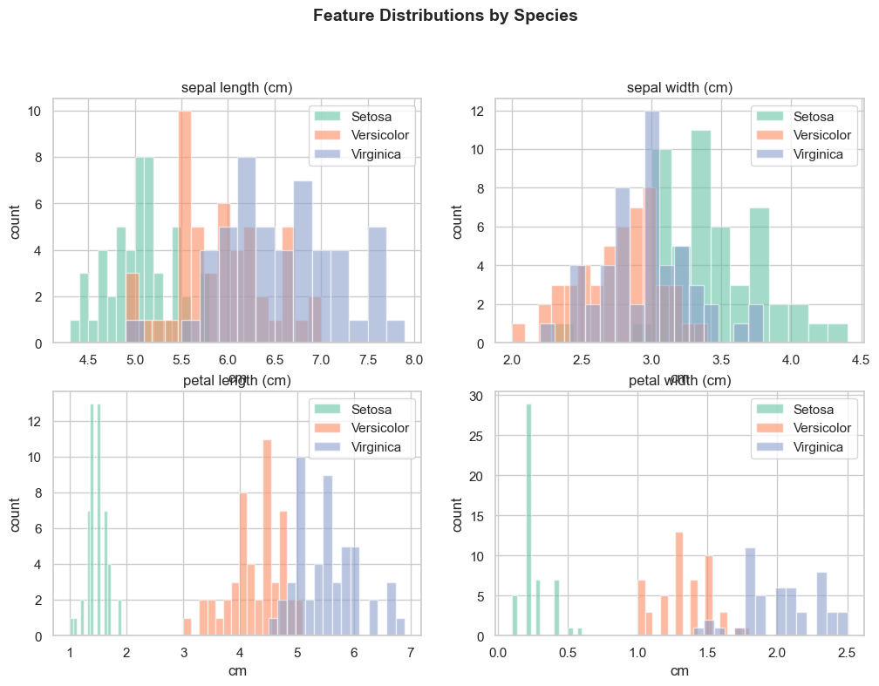
EDA CNTD:
Plots a histogram per feature, with all three species overlaid for direct comparison
Each bar represents the frequency of flowers falling within a measurement range
Low overlap between species curves indicates high discriminative power for that feature
Petal length and petal width show minimal overlap across species = strong predictors
Sepal width shows significant overlap = weak predictor on its own

Slide 7
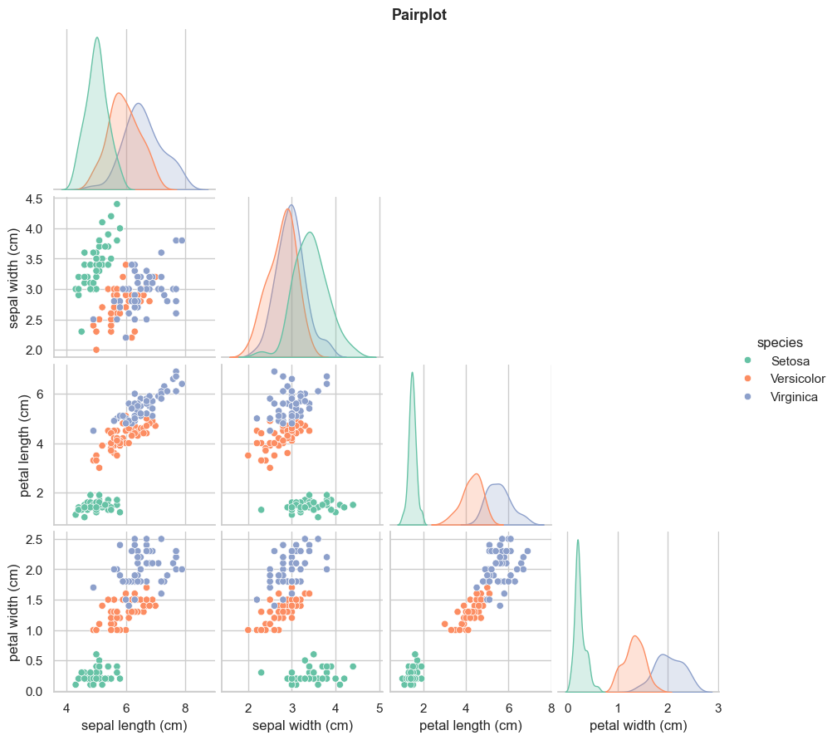
EDA CNTD:
Generates scatterplots for every possible feature pair, colored by species
Diagonal panels show the distribution of each individual feature rather than a scatterplot
corner=True renders only the lower triangle, eliminating redundant mirrored panels
The petal length vs petal width panel shows near-perfect class separation, which directly explains why these features carry the highest importance scores in the Random Forest model later

Slide 8

DATA ENGINEERING AND PREPROCESSING
Need for Standard Scaler:
Many machine learning models perform poorly if numerical features are on wildly different scales. Features with larger raw ranges can artificially dominate the model's loss function.
Pipeline to use Standard Scaler:
Impact:
Standardizing features to have a mean of 0 and a variance of 1 ensures that every measurement contributes equally to model convergence, preventing computational bias and weight distortion.
Data Splitting Architecture: Executing a strict 75/25 train_test_split to get two sets of data: one to train the model on, one to test the model.
Used the make_pipeline function to skip manual scaling with the models.

Slide 9
MODEL SELECTION
01 The Random Guessing Floor (33.3%):
Because the 3 target classes are perfectly balanced in the underlying data, any viable machine learning algorithm must comfortably outperform a random distribution baseline of exactly 1/3

Slide 10
MODEL SELECTION
02 Logistic Regression:
Unlike linear regression, which predicts continuous values it predicts the probability that an input belongs to a specific class.
It is used for binary classification where the output can be one of two possible categories such as Yes/No, True/False or 0/1.
It uses sigmoid function to convert inputs into a probability value between 0 and 1.
Multinomial Logistic Regression: This is used when the dependent variable has three or more possible categories that are not ordered. For example, classifying animals into categories like "cat," "dog" or "sheep." It extends the binary logistic regression to handle multiple classes.

Slide 11
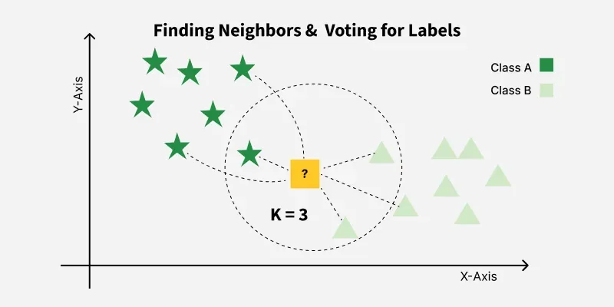
MODEL SELECTION
03 K=Nearest Neighbors:
It works by identifying the K closest data points to a given input and making predictions based on the majority class or average value of those neighbors.
Classifies data based on similarity with nearby data points
Uses distance metrics like Euclidean distance to find nearest neighbors
Since KNN makes no assumptions about the underlying data distribution, it makes it a non-parametric and instance-based learning method.

Slide 12
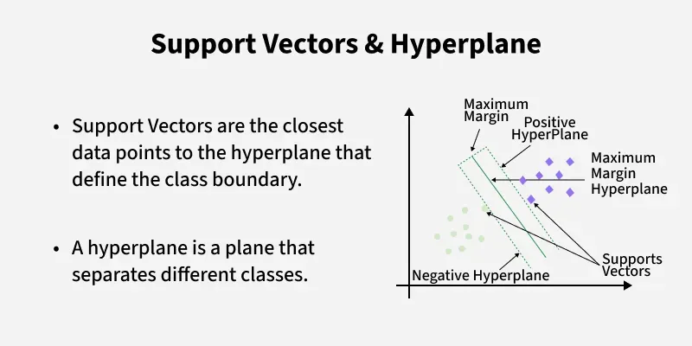
MODEL SELECTION
04 Support Vector Machine (svm):
it tries to find the best boundary known as hyperplane that separates different classes in the data. It is useful when you want to do binary classification like spam vs. not spam or cat vs. dog.
The main goal of SVM is to maximize the margin between the two classes. The larger the margin the better the model performs on new and unseen data.

Slide 13
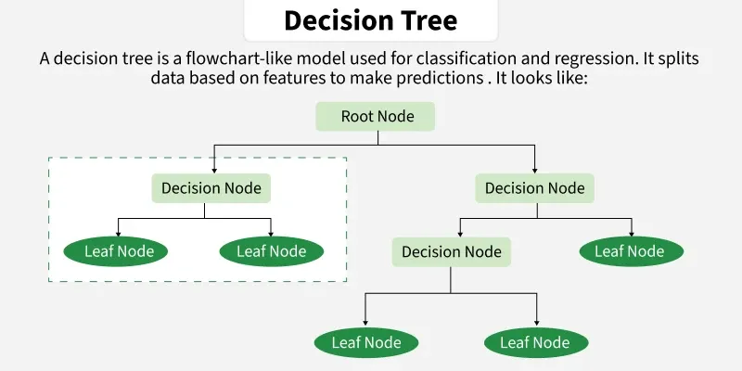
MODEL SELECTION
05 Decision Tree:
It is used for both classification and regression tasks. It has a hierarchical tree structure which consists of a root node, branches, internal nodes and leaf nodes. It works like a flowchart that helps in making step-by-step decisions, where:
Internal nodes represent attribute tests
Branches represent attribute values
Leaf nodes represent final decisions or predictions.

Slide 14
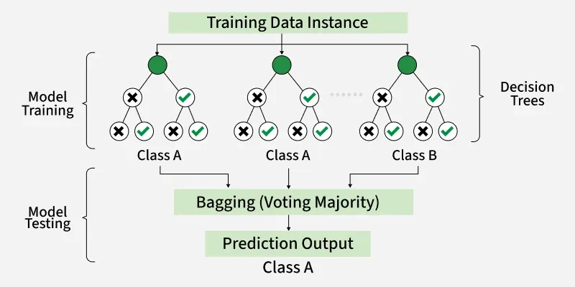
MODEL SELECTION
06 Random Forest:
Random Forest is a machine learning algorithm that uses many decision trees to make better predictions. Each tree looks at different random parts of the data and their results are combined by voting for classification or averaging for regression which makes it as ensemble learning technique. This helps in improving accuracy and reducing errors.

Slide 15
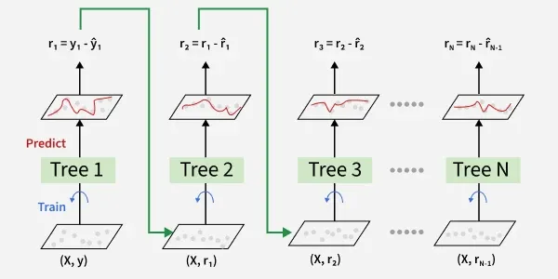
MODEL SELECTION
06 Gradient boosting:
Gradient Boosting is a boosting algorithm and here each new model is trained to minimize the loss function such as mean squared error or cross-entropy of the previous model using gradient descent. In each iteration the algorithm computes the gradient of the loss function with respect to predictions and then trains a new weak model to predict this gradient. Predictions of the new model are then added to the ensemble (all models prediction) and the process is repeated until a stopping criterion is met.

Slide 16

MODEL SELECTION
07 Naive Bayes:
Naive Bayes is a machine learning classification algorithm that predicts the category of a data point using probability. It assumes that all features are independent of each other. Naive Bayes performs well in many real-world applications such as spam filtering, document categorization and sentiment analysis. It is used mostly in high-dimensional text classification

Slide 17
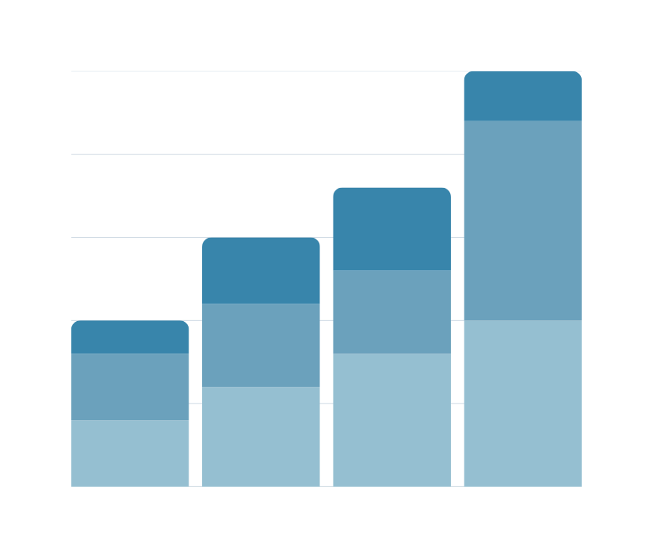
EVALUATION AND METRICS
Using cross validation cross_val_score(model, X_train, Y_train, cv=5, scoring='accuracy') to extract accuracy averages across all 7 models.
Using graphs to assess which approach excels at resolving the Versicolor / Virginica boundary overlap.
Selecting the top-performing pipeline from the CV stage to evaluate against the untouched hold-out test set, to obtain final metrics like accuracy, confusion matrices, and precision scores.

Slide 18
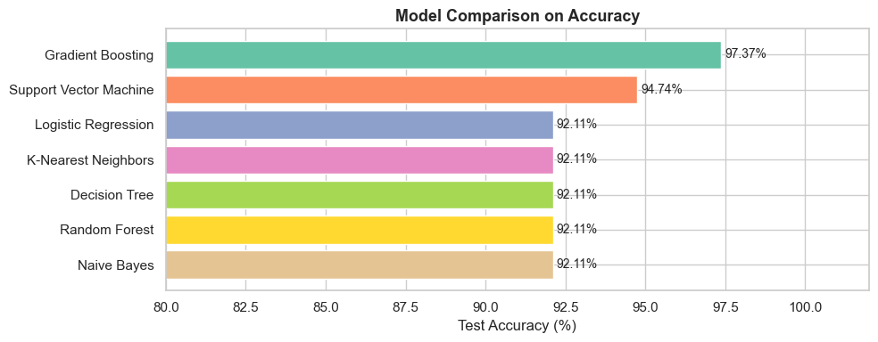
VISUALIZATIONS:
Simple horizontal bar chart comparing the accuracies of the different models with each other.
We can see that the Gradient Boosting algorithm does the best.

Slide 19
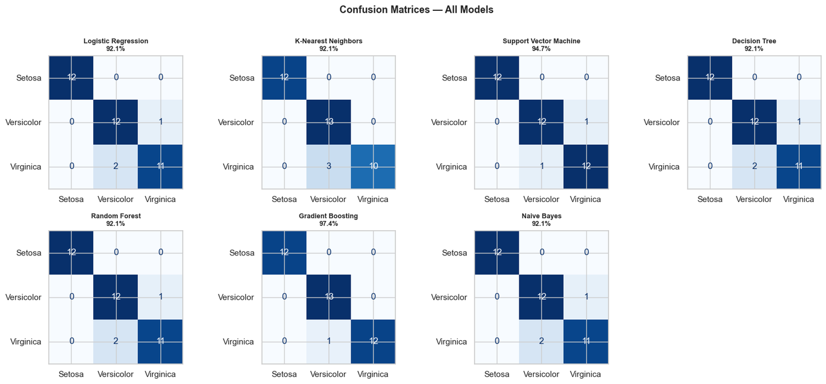
VISUALIZATIONS:
Confusion matrix is a simple table used to measure how well a classification model is performing. It compares the predictions made by the model with the actual results and shows where the model was right or wrong.
True Positive (TP):
True Negative (TN):
False Positive (FP): Type I error
False Negative (FN): Type II error.

Slide 20
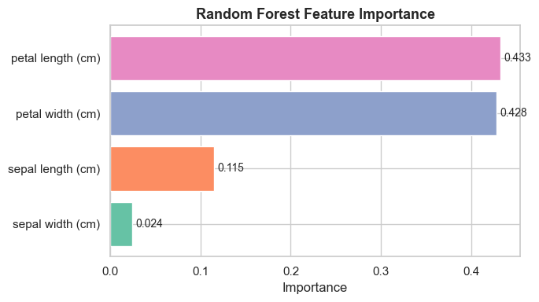
VISUALIZATIONS:
Feature Importance in Random Forests measures how much each feature contributes to the model’s prediction accuracy. It helps in identifying the most influential input variables, improving performance, interpretability and computational efficiency.

Slide 21
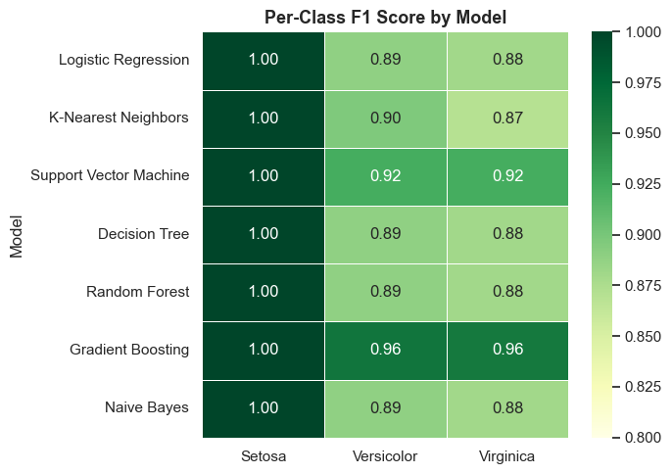
VISUALIZATIONS:
F1 Score is a metric used to evaluate the performance of a classification model. It combines precision and recall into a single value and is especially useful when the dataset has imbalanced classes.
Combines precision and recall into one metric.
Useful for imbalanced datasets.
Higher F1 Score means better performance.

Slide 22
PROBLEMS ENCOUNTERED:
Understanding the requirement for standard scaler: it threw off my accuracies many times.
Choosing which graphs to use for visualizations and which ones to use for EDA.
A lot of unfamiliar keywords that kept throwing me off even if I had experience with it in a different context.
The different evaluation metrics were a little confusing

Slide 23
CONCLUSION
Thus, an understanding of the basic supervised models was achieved.
Built a reliable model comparison script that works on the classic Iris dataset and gives a comparitive look at the 7 models.
Confirmed an elite 97.37% accuracy score, proving that the models easily handle complex classification limits.

Slide 24
REFERENCES:
GeeksforGeeks. (n.d.). Support vector machine algorithm. GeeksforGeeks. Retrieved May 31, 2026, from GeeksforGeeks SVM Article
GeeksforGeeks. (n.d.). Decision tree: Introduction with example. GeeksforGeeks. Retrieved May 31, 2026, from GeeksforGeeks Decision Tree Article
GeeksforGeeks. (n.d.). Gradient boosting in machine learning. GeeksforGeeks. Retrieved May 31, 2026, from GeeksforGeeks Gradient Boosting Article
GeeksforGeeks. (n.d.). Naive Bayes classifiers. GeeksforGeeks. Retrieved May 31, 2026, from GeeksforGeeks Naive Bayes Article
GeeksforGeeks. (n.d.). K-nearest neighbours. GeeksforGeeks. Retrieved May 31, 2026, from GeeksforGeeks KNN Article
GeeksforGeeks. (n.d.). Understanding logistic regression. GeeksforGeeks. Retrieved May 31, 2026, from GeeksforGeeks Logistic Regression Article
GeeksforGeeks. (n.d.). Random forest algorithm in machine learning. GeeksforGeeks. Retrieved May 31, 2026, from https://www.geeksforgeeks.org/machine-learning/random-forest-algorithm-in-machine-learning/
GeeksforGeeks. (n.d.). Feature importance with random forests. GeeksforGeeks. Retrieved May 31, 2026, from https://www.geeksforgeeks.org/machine-learning/feature-importance-with-random-forests/
GeeksforGeeks. (n.d.). F1 score in machine learning. GeeksforGeeks. Retrieved May 31, 2026, from https://www.geeksforgeeks.org/machine-learning/f1-score-in-machine-learning/
GeeksforGeeks. (n.d.). Confusion matrix in machine learning. GeeksforGeeks. Retrieved May 31, 2026, from https://www.geeksforgeeks.org/machine-learning/confusion-matrix-machine-learning/

Slide 25
THANK YOU
VERY MUCH

